Slide 1

ECE 5397/6397:
Introduction to Robotics
Lecture 6:
Forward kinematics examples
Reference: Chapter 3.1 and 3.2, RD&C
Instructor: Aaron Becker

Slide 2
Welcome!
Robot parts ordered. We will build them in class next Tuesday and Thursday. You need a #1 Phillips Screwdriver
Next Thursday is a career fair.
Next 2 lectures will be on YouTube
http://www-cvr.ai.uiuc.edu/~lab/ece470/robotica/robotica.m
http://www-cvr.ai.uiuc.edu/~lab/ece470/robotica/robotica_manual.pdf

Slide 3
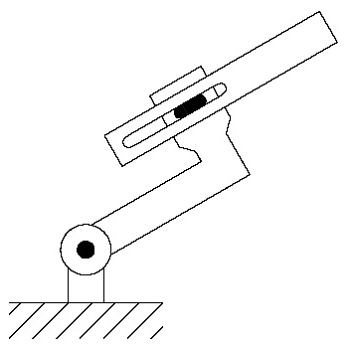
RP arm

Slide 4
RP arm Answer

Slide 5
Elbow manipulator

Slide 6
Elbow manipulator Ans

Slide 7
3-link RPR arm

Slide 8
3-link RPR arm

Slide 9
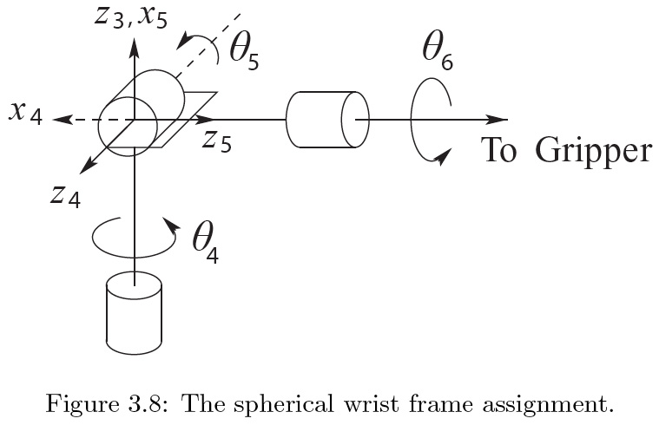
Spherical Wrist
Wrist center:

Slide 10
Spherical Wrist

Slide 11
Spherical Wrist ans

Slide 12
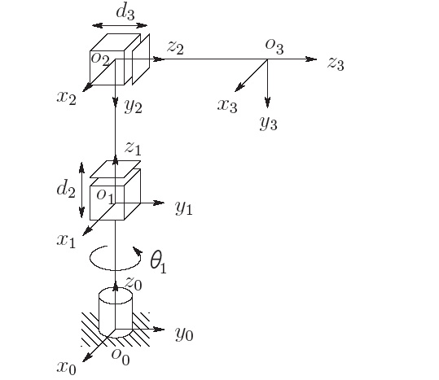
Review: Cylindrical robot

Slide 13
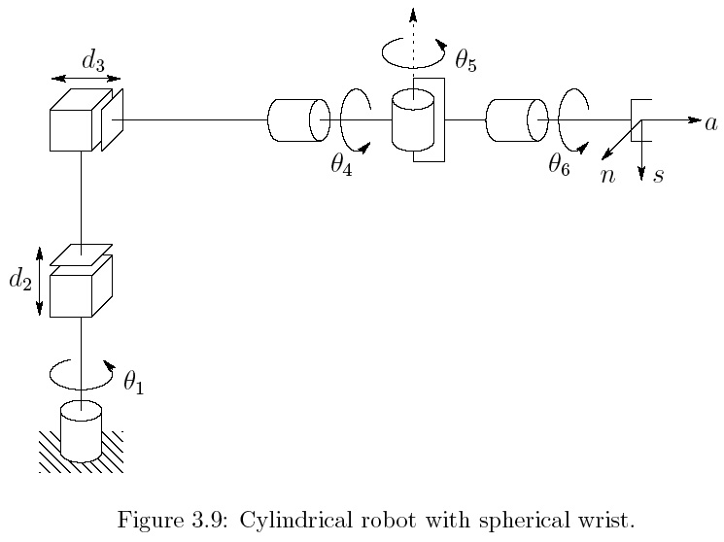
Cylindrical robot & Spherical Wrist
Notes:
edit

Slide 14
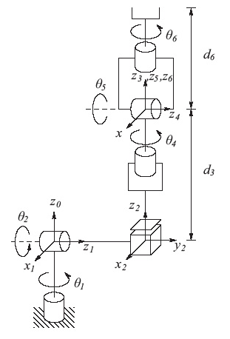
Stanford Manipulator
Notes:
edit

Slide 15
Stanford Manipulator
Notes:
edit

Slide 16
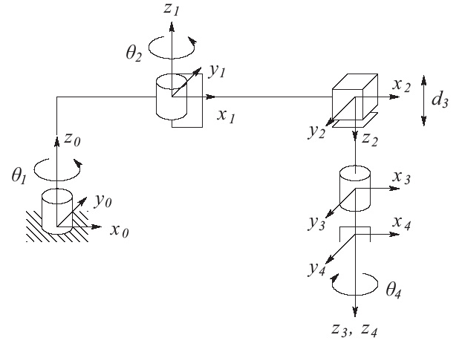
SCARA Manipulator
Notes:
edit

Slide 17
For the Next Class
Today: Forward kinematics examples
Next: Inverse kinematics
Study Ch. 3.3 for Lecture 7

